Slide 1


Slide 2
Project Ideation
July 2024

Slide 3

Weekly Agenda
Week 1: Introductions
Week 2: Project Ideation
Week 3: Database Design and Setup
Week 4: Backend Development and Version Control
Week 5: API Development
Week 6: JavaScript Frameworks and Frontend Development
Week 7: Frontend Development and Putting it All Together
Week 8: Presentations

Slide 4
Project Ideation
Workspace Preparation
Tasks

Slide 5
Project Ideation

Slide 6
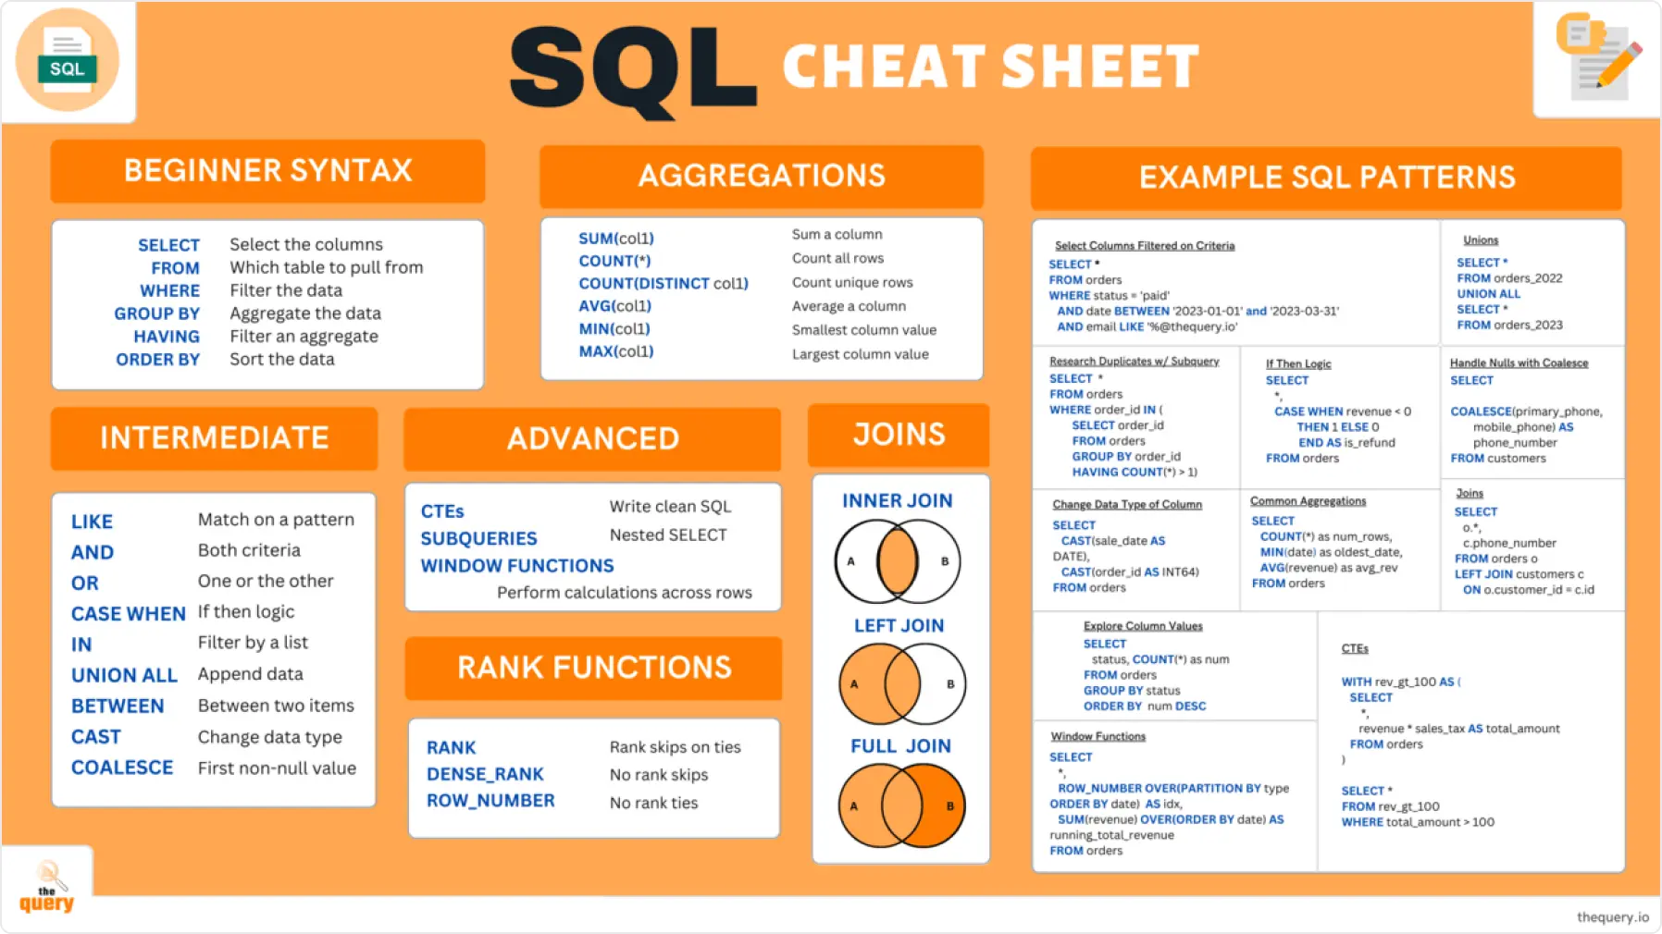
SQL Overview

Slide 7
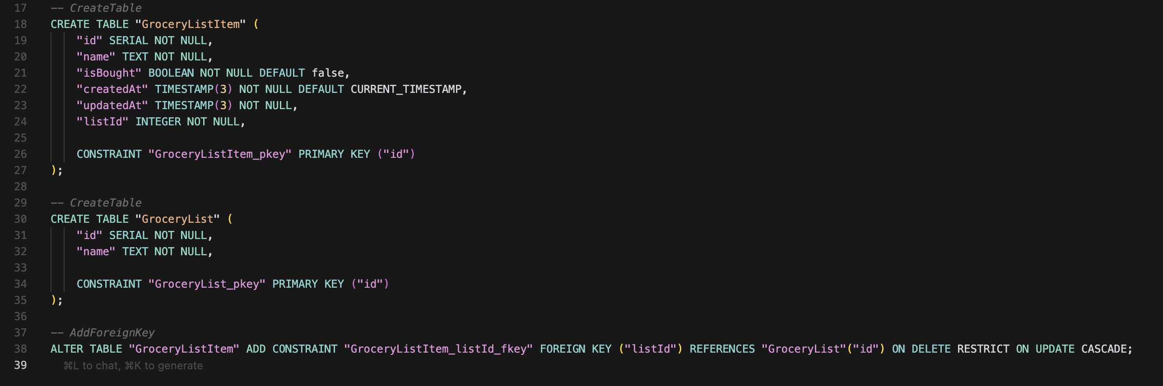
Data Tier
Technology: PostgreSQL and Prisma
Schema Creation for Grocery List

Slide 8
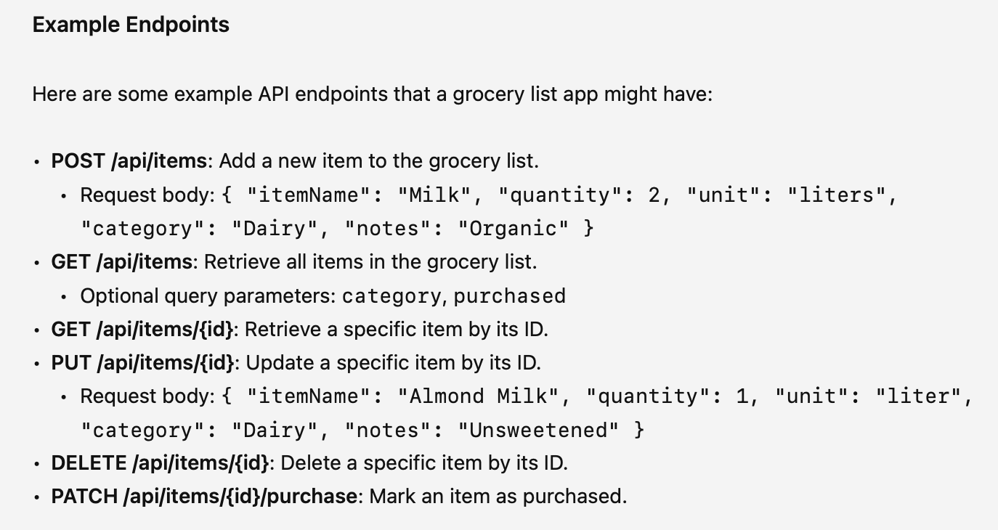
API Tier
Will accept requests from the frontend and save data in the database.
Ensures integrity of the data coming from the frontend.
CRUD operations

Slide 9
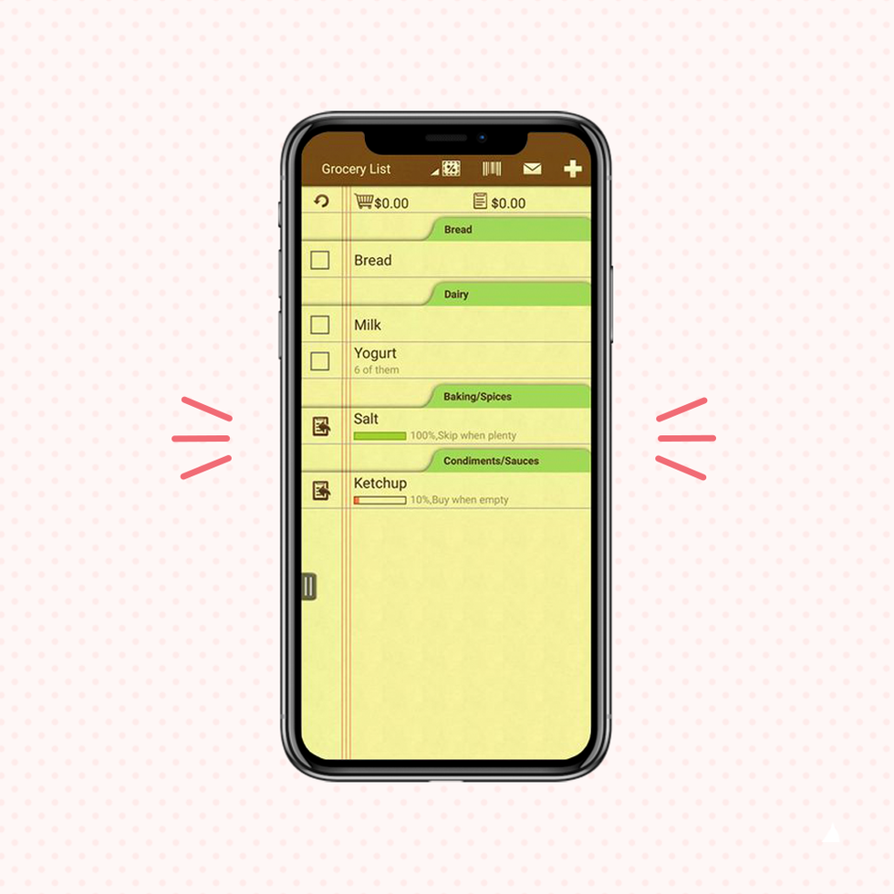
Frontend

Slide 10
Workspace Preparation

Slide 11
Prisma!
Let’s do a demo!

Slide 12

Tasks
Sign up for Prisma: https://prisma.io
Think of what dataset you want to use.
Walk through the intro to create a prisma instance, migrations, and run some queries!

